Slide 1
BALANCED BINARY SEARCH TREES

Slide 2
Definition:
A Subgraph of a graph is a graph whose vertex set is a subset of the vertex set , that is , and whose edge set is a subset of the edge set , that is .
Essentially, a subgraph is a graph within a larger graph.

Slide 3
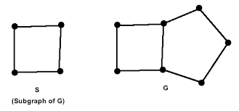

Slide 4

All the edges and vertices of G might not be present in S; but if a vertex is present in S, it has a corresponding vertex in G and any edge that connects two vertices in S will also connect the corresponding vertices in G. All of these graphs are subgraphs of the first graph.

Slide 5
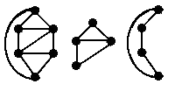
A vertex-induced subgraph is one that consists of some of the vertices of the original graph and all of the edges that connect them in the original. An edge-induced subgraph consists of some of the edges of the original graph and the vertices that are at their endpoints.
The second two figures are vertex-induced subgraphs of the first figure.

Slide 6
The second two figures are vertex-induced subgraphs of the first figure.

Slide 7
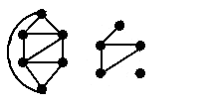
The second figure is a subgraph of the first figure,
but it is neither edge-induced nor vertex-induced.

Slide 8
A spanning subgraph is a subgraph that contains all the vertices of the original
graph. A spanning tree is a spanning subgraph that is often of interest.
A cycle in a graph that contains all the vertices of the graph would be called a
spanning cycle. However it's more common name is a Hamiltonian cycle.

Slide 9
Thank You

